Slide 1
Geographically visulize
File created on: 09-Nov-21 3:51:40 PM

Slide 2
Scenarios:
1. Create a Map view to represent all the states with country.
2. Check your map for south region.
4. Check the sales for south region.
5. Find the state that has highest sales.
6. Represent your sales in USD.
7. Edit color for you map.
8. Show profit for all the states in your map in south region.
9. Find out the name of some states having negative profit.
10.Note down the name of the states having lowest profit and highest profit.

Slide 3
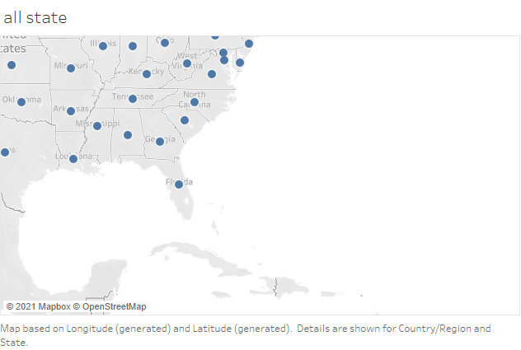
1. Create a Map view to represent all the states with country.

Slide 4
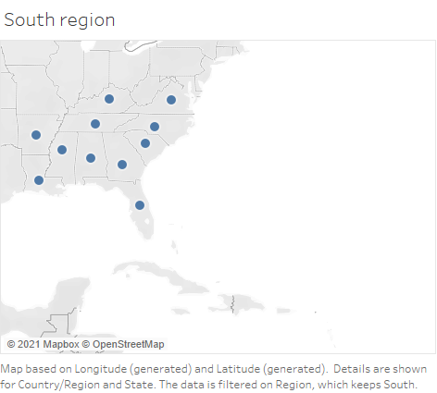
2. Check your map for south region.

Slide 5
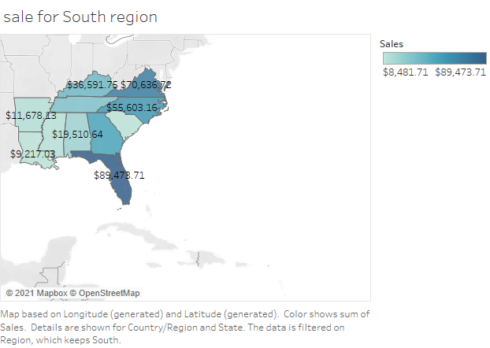
3. Check the sales for south region.
5. Find the state that has highest sales.
Ans- Florida

Slide 6
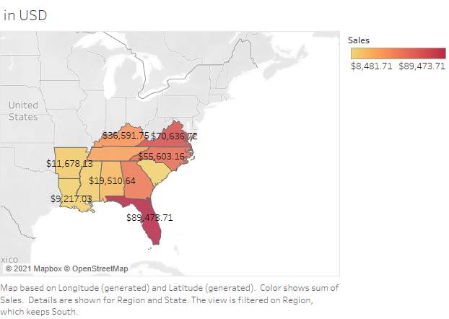
6. Represent your sales in USD.
7. Edit color for you map.

Slide 7
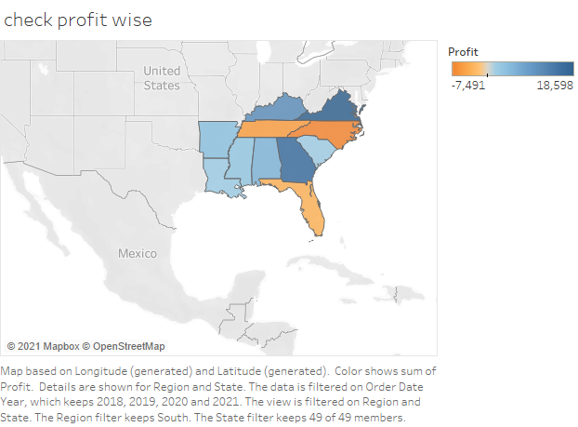
8. Show profit for all the states in your map in south region.
9. Find out the name of some states having negative profit.
Ans – Florida, North carolina, Tennessee

Slide 8
10.Note down the name of the states having lowest profit and highest profit.
Ans-
Highest profit – Virginia
Lowest profit -- North carolina

